Slide 1









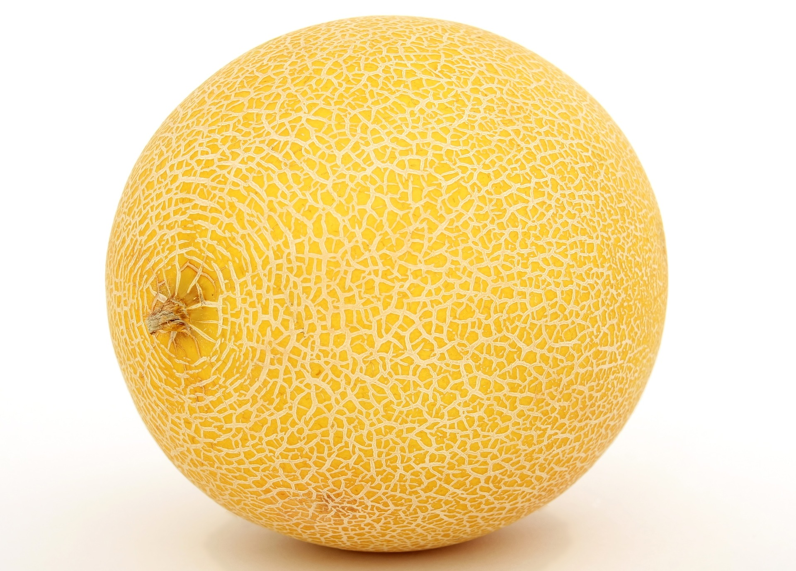
Send NUTEZ Food Tracking done right.
Team: Sebastian Rossi, Sebastian Lutz
Supervisors: Adria Mallol-Ragolta, Alexander Kathan
Winter Semester 2021-2022

Slide 2
Content
1
Introduction
2
Data
3
Implementation
4
Live Demo
5
Challenges and Conclusion

Slide 3
Introduction
Food Tracking done right.
Nutrition diary
Automated food detection
Personal and meal nutrition scores
Detailed data screens

Slide 4
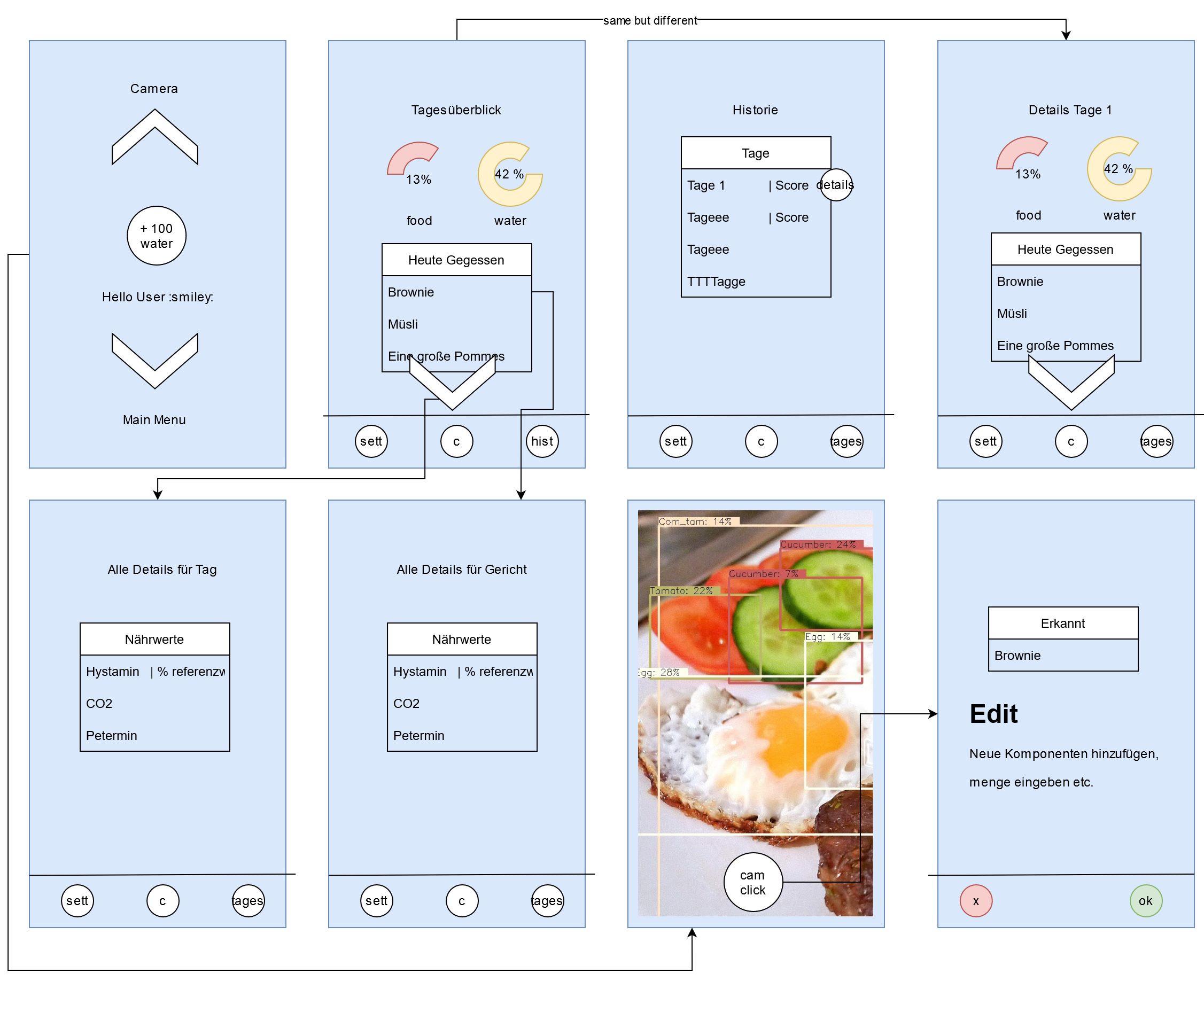
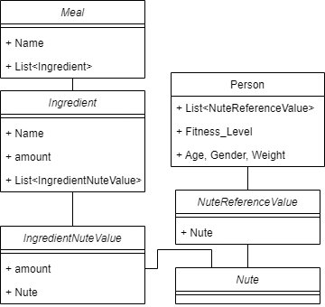
Implementation
Wireframe and Architecture

Slide 5
Implementation
Food Detection
Based on YOLOv5 with Pre-trained weights for Food
Model converted and built for the NCNN framework
Call the model via JNI
Send ImageProxy Stream/Images
Receive predictions and Box-coordinates
Original implementation: https://github.com/lannguyen0910/food-recognition
https://www.researchgate.net/publication/335833242_FoodTracker_A_Real-time_Food_Detection_Mobile_Application_byDeep_Convolutional_Neural_Networks

Slide 6
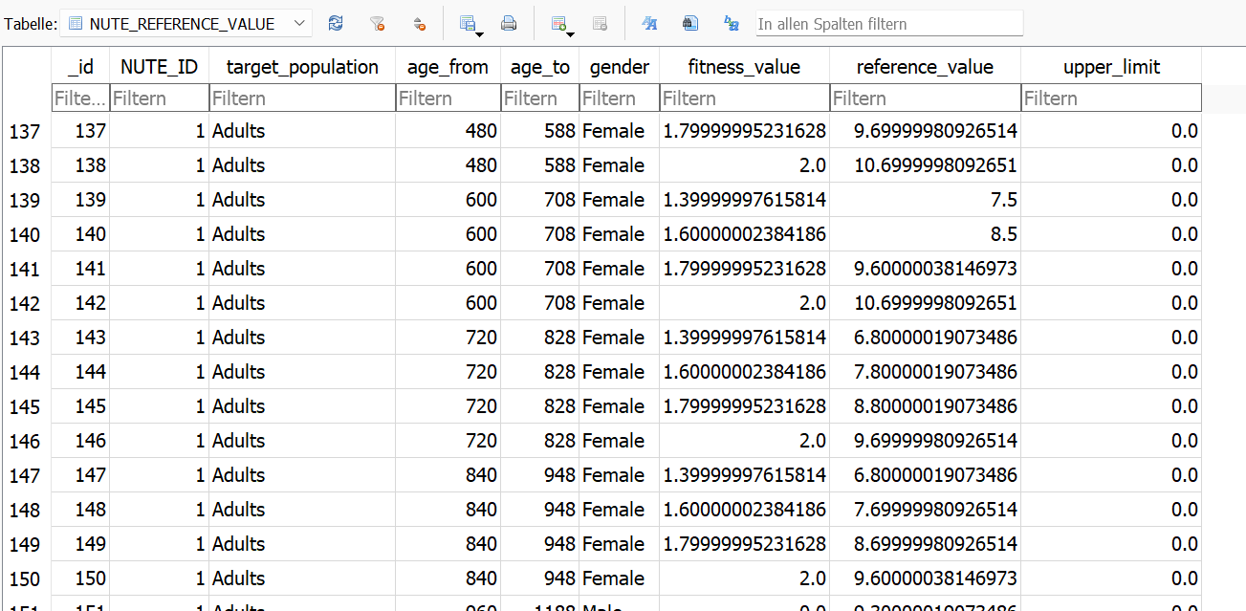
Data
Database and Nutrition API
Daily nutrition reference values: https://multimedia.efsa.europa.eu/drvs/index.htm
Nutrition facts: https://fdc.nal.usda.gov/
Local database for meals

Slide 7
Live Demo
Demo time….

Slide 8
Challenges and Conclusion
…and how we overcame them
Challenges
Find and use existing model -> Training time would be too long
Find suitable models -> limited performance
UI -> try to keep it simple
Database ORM -> hibernate not found
Extensions
Recipe API and suggestions based on your nutrition intake
Better model
Even more detailed statistics
(cannibal mode if camera detects a human…)

Slide 9
Send NUTEZ.
Food tracking done right.
Team: Sebastian Rossi, Sebastian Lutz
Universität Augsburg
www.uni-augsburg.de

